Slide 1
Zowe Support (including Long Term Support Release) Discussion https://github.com/zowe/zlc/issues/72
Notes:
Opening Slide

Slide 2
Agenda
Brief Level Set
End Goal (Node.js as example)
Continuous Delivery (CD)
Long Term Support Release (LTSR)
Four Questions (+/-)
What is Zowe’s Support Policy?
Assuming CD, what is the criteria for first LTSR?
When might we get there with focused effort?
What is the criteria for LTSR fixes?
Proposed Next Steps

Slide 3
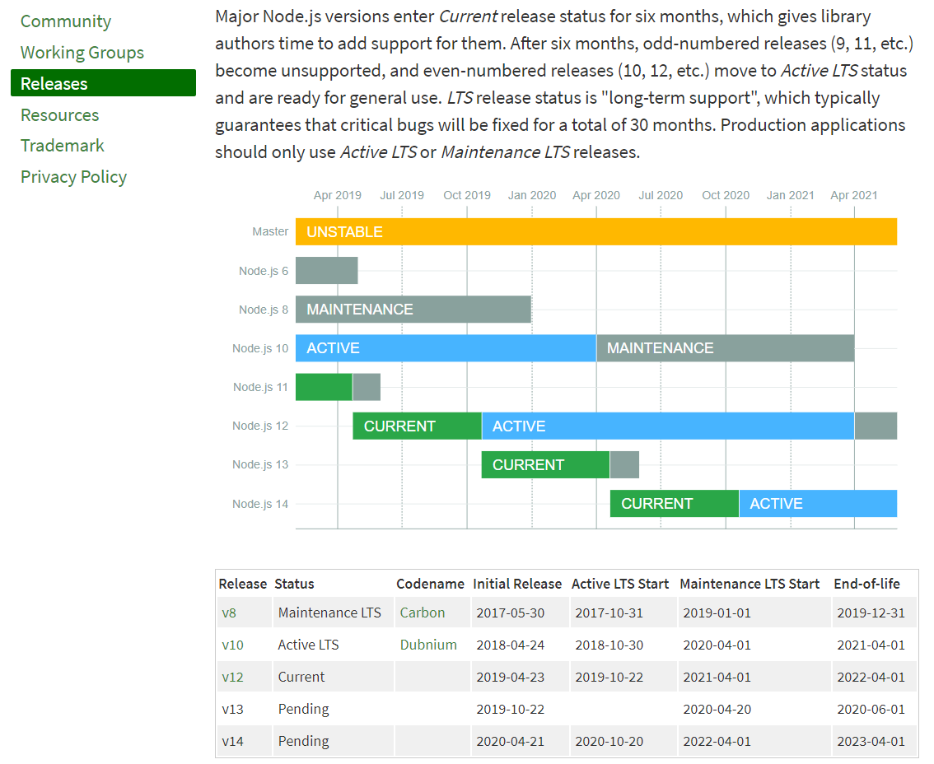
https://nodejs.org/en/about/releases/
I think our goal should be is a public, well documented version and release support policy

Slide 4
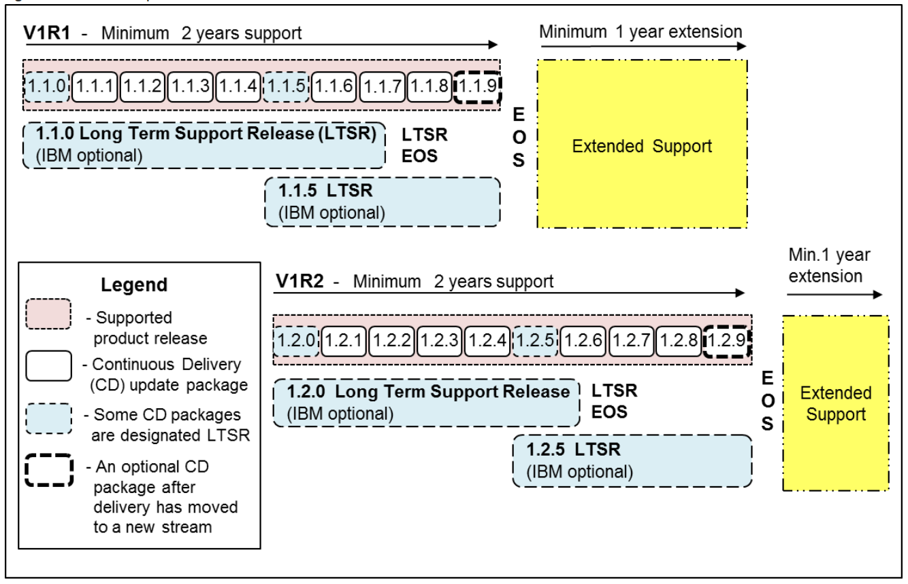
CD Concept (plagiarized from IBM policy)
Two code streams
Periodic releases with enhancements and fixes for customers willing to take changes
Less frequent (more stable) designated releases as LTSR- with fixes only going forward for risk adverse customers
Notes:
More info here https://www-01.ibm.com/support/docview.wss?uid=ibm10718163
A different example https://www-01.ibm.com/support/docview.wss?uid=ibm10869798

Slide 5
Applied to Zowe
Zowe Releases today (CD) – fixes and enhancements
Zowe LTSR – Critical Fixes Only
Critical fixes?
Is LTSR the last release of a version?
No “extended support” – source code available for everyone (question on whether build environment still available)

Slide 6
Four Questions
What is Zowe’s Support Policy?
Zowe releases (in an active Version) are supported today using a CD model (defects addressed in release code stream)
Defects addressed based on impact, complexity and market demand
LTSR – TBD
Assuming CD, what is the LTSR criteria? (Must haves or Nice to Haves)
CUPIDS (includes SMP/E packaging)
Common logging
Tracing/Debug tools
Message IDs
SSO
HA
MFA (for Zowe not just github)
Market feedback
When might we get there?
Target 2020?
Is there a rush? Can CD be used thru 2020?
Align with V2 target
What is the criteria for LTSR fixes?
Security fixes
“Production impacts”
…?

Slide 7
Proposed Next Steps
Spin up a workgroup/squad to:
Research how other open source communities address “support” including LTSR fix criterial
Obtain input from each squad on what they think MVP is for LTSR and when it is achievable
Survey Zowe consumers/exploiters on their requirements for LTSR
Is LTSR necessary in next 1-2 years?
Document – as best we can – the requirements for a build environment for LTSR
Draft a support policy for review and comment by the community
Document how LTSR and vNext interrelate

Slide 8

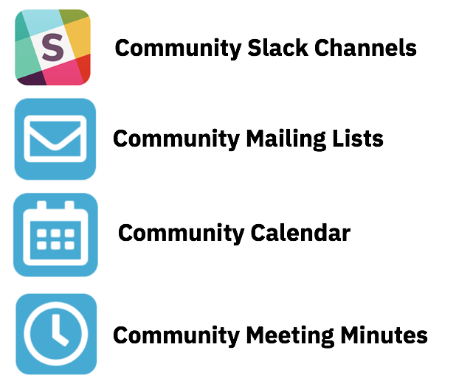
Getting Involved with Zowe!
Project Community site
https://zowe. org
Zowe “vNext” Roadmap
https://github.com/zowe/zlc/blob/master/tracking/Roadmap.md
Access to Zowe Convenience Deliverables
https://zowe.org/download
Review Zowe squads, missions and activities
https://zowe.org/contribute/
Project Governance
https://zowe.org/about-us/
GitHub
https://github.com/zowe
Project Documentation (includes user and install guides)
https://zowe.github.io/docs-site/
Developer Tutorials
https://zowe.github.io/docs-site/guides/intro.html
https://developer.ibm.com/tutorials/zowe-step-by-step-tutorial/
Notes:
Engagement slide -

Slide 9



Get involved in the Zowe community
Join Open Source Community @ https://www.openmainframeproject.org/projects/zowe
PROJECTS
Participate in and contribute to the Zowe developer community at zowe.org
Learn how your organization can become a steward and supporter of this project with Open Mainframe Project membership at openmainframeproject.org/about/join
DEVELOPER
COMMUNITY
PLATFORM
PARTICIPATION
Ecosystem
PROFITS
PRODUCTS
PROMOTION
SOFTWARE
Notes:
Closing slide

